Slide 1
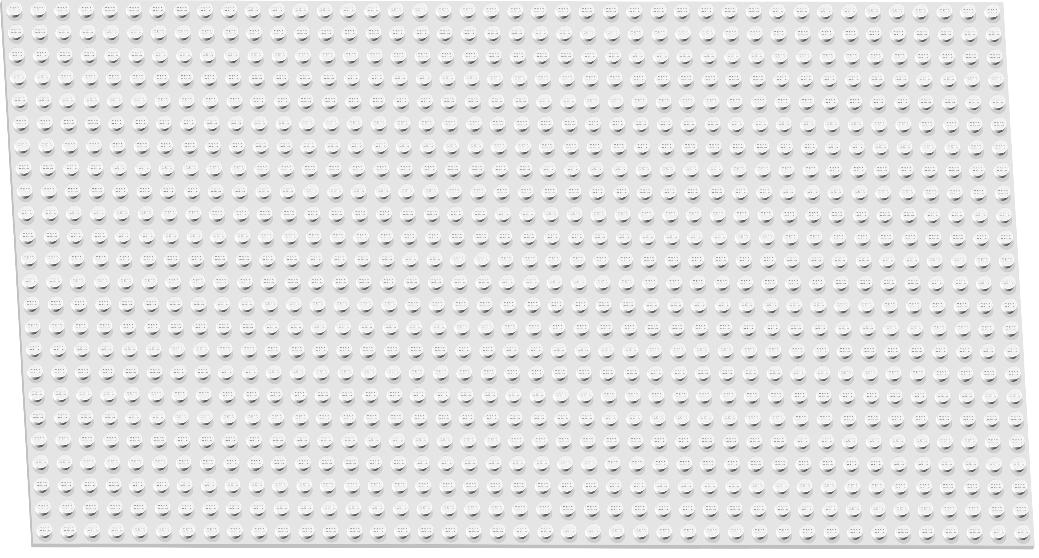

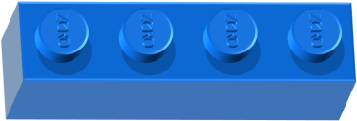
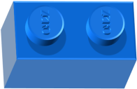
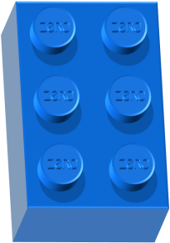
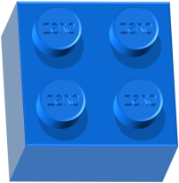
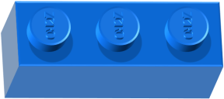
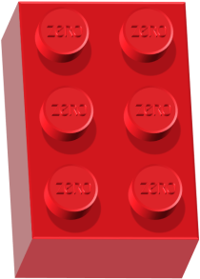
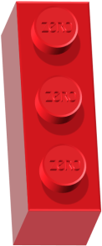
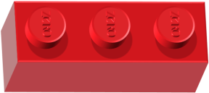
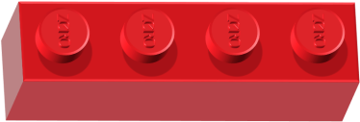
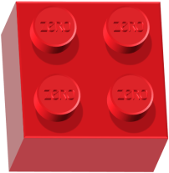
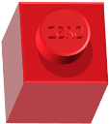
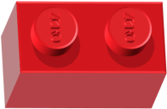
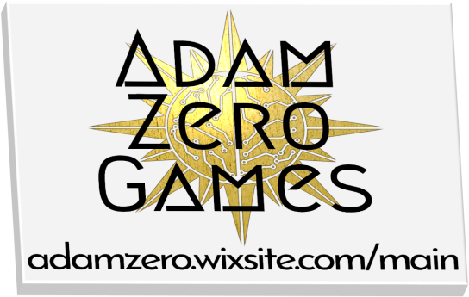

Notes:
Game and template design by Adam Groff. Game templates available at adamzero.wixsite.com/main. Game concept inspired by ‘Sentence Craft’ by Kimberly Teacher (rtw_acrobat). This template may be used, shared and redistributed for educational purposes, but may not be sold or posted to a site that seeks to profit from it (either through a subscription fee or a request for donations), by anyone other than its creator. All sounds are used in accordance with their respective licenses. Sounds may be re-used / redistributed according to their respective licenses. Images and music may not be re-used / redistributed without the permission of their creator.
Images and music created by Adam Groff. Plastic brick sounds by leandri140029 (CC0, freesound.org).
Font (Poppins Medium) from Google Fonts (Open Font License).

Slide 2
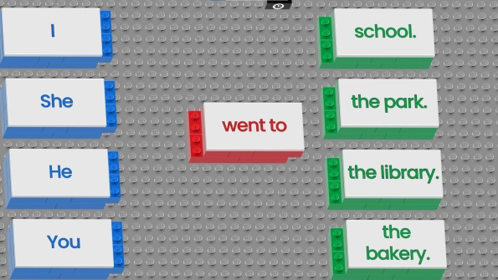
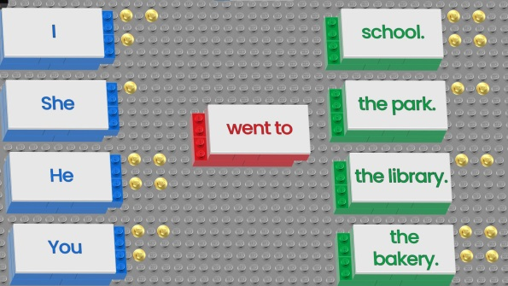
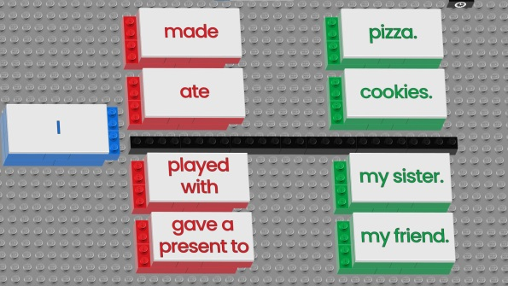
Playing the Game:
10-20 minutes
This is an individual or team writing game, where students can create their own sentences from the ‘blocks’ of words on each slide. Students choose one block of each color and write the sentence that results from their choices, then see how many points each block they chose is worth.
When you advance to a slide, two of three block colors will provide choices for the students (one block color is always a fixed part of the sentence, typically either the subject or the verb). Click once to start a 40 second timer and the background music (the timer helps to focus the students and let them know they should make a choice and write).
Once the timer and music are finished, click again to show the points for the choices from the first block color (either blue or red). Click one more time to show the points for the choices from the green blocks. (If time permits, you can have students / teams read what they wrote before showing points- this also helps lower-level students to better understand the task.)
The only slide layouts that require more explanation are the ones with the horizontal black line or ‘wall’ in the middle: students may choose a red block from above or below the line, then they must also choose a green block from that same side of the line (in other words, if they choose a red block from above the line, they cannot choose a green block from below the line). These slides help with lesson content that is difficult to make into ‘fully flexible sentences’ by allowing you to limit the choices to those that make logical or grammatical sense.
Notes:
Game info. Game and template design by Adam Groff.

Slide 3
Editing This Template:
Click on the text boxes to edit the text according to your lesson content. Some lessons are easier to fit into the ‘flexible sentence construction’ concept of this game, while others will require a bit of ‘stretching’ in terms of using alternative pronouns and verbs from what was in the lesson (ex: ‘What are you doing?’, ‘What is she watching?’, ‘What is Tom playing?’). (I personally like that the latter provides some variety for higher level students to improve grammatical fluency.)
To allow for multiple uses with the same group of students, there are alternate slides (labeled ‘Alt Board _’) for each of the 6 game board slides (divided into sections after the End Credits slide). Each game board slide has two alternates with randomized points and different layouts that you can drag up to replace the original in the ‘Game Boards’ section. You can then right click on the alternate slide in the preview pane and ‘unhide’ it. (If you don’t mind repeating music tracks, you can also mix and match these however you like.)
*Obsessive Text Tip- When your words and / or phrases won’t quite fit into the ‘blocks’ without spilling out beyond them, you can use ‘condensed’ character spacing (in the ‘Font’ dialog box) and ‘exactly’ line spacing (in the ‘Paragraph’ dialog box) to squeeze them in without dropping the font size to where the words are hard to read.*
*Actually Important Note- Deleting or moving objects can break animation sequences. I recommend storing an unaltered copy of this game template in a separate folder as a back-up.*
Credits: Game and template design by Adam Groff
Game concept inspired by ‘Sentence Craft’ by Kimberly Teacher (rtw_acrobat).
Images: All images created by Adam Groff
Audio: All music created by Adam Groff
Plastic brick sounds by leandri140029 (CC0, freesound.org). Power-up sounds by Adam Groff.
Notes:
Editing and Credits. Game and template design by Adam Groff.

Slide 4
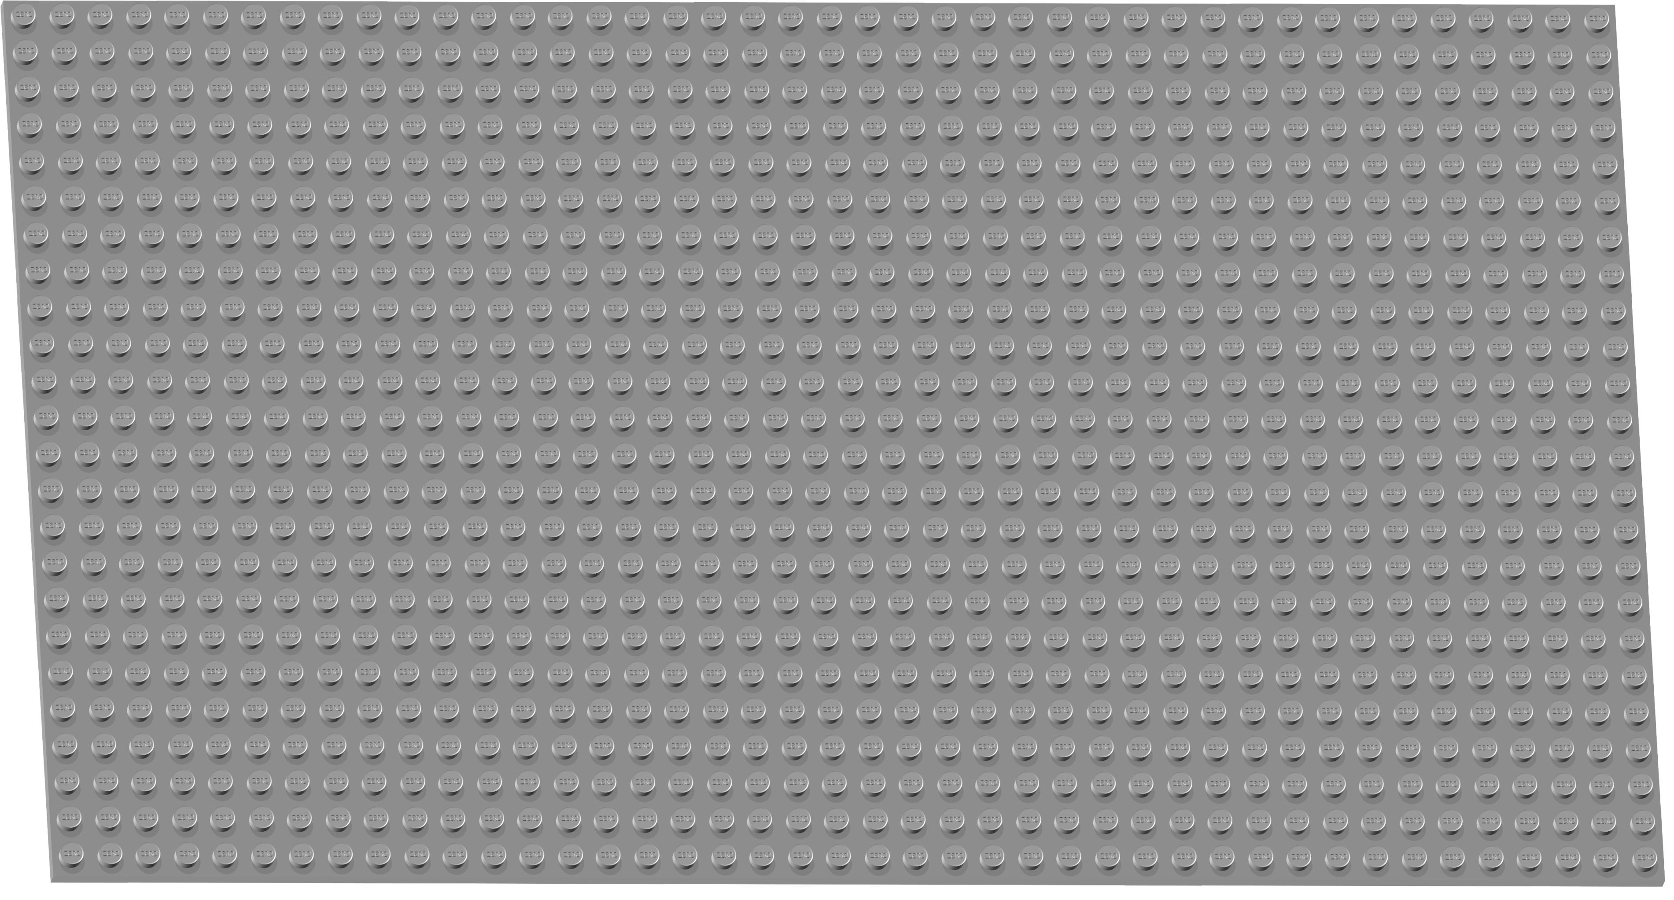
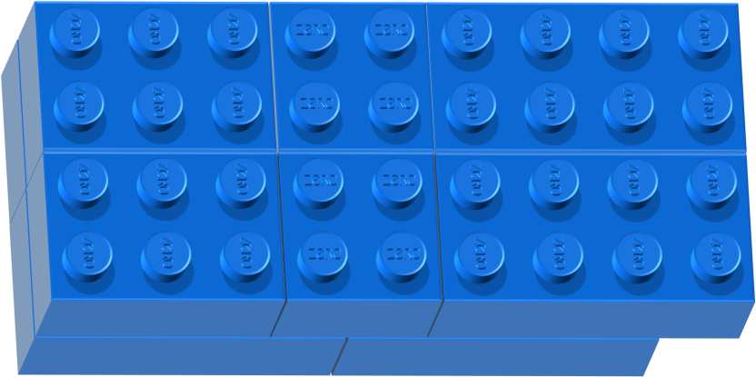
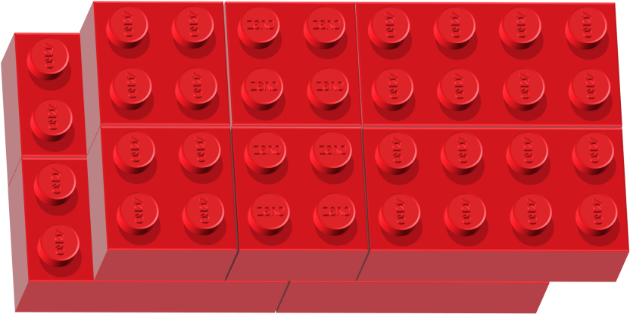

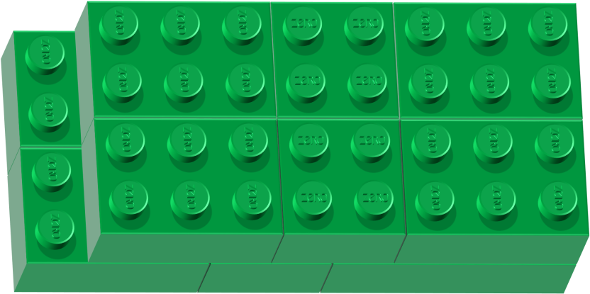



Is this
your
your
ball?
my
watch?
Is this
Is this
her
your
cap?
How to play:
Choose 1 block of each color.
Write the sentence.
Then, check your points!
Ready?
his
pencil?
Notes:
Instructions Slide. Game and template design by Adam Groff.

Slide 5
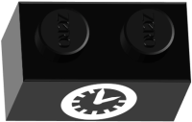
get up
go to school
What time do you
get home
go to bed
Notes:
Board 1 (Red Green)- Click on the text boxes to edit them for your lesson content. NOTE- deleting, moving, or altering animations for other objects may cause problems with the animation sequences. Game and template design by Adam Groff.

Slide 6
get up
at 7:00
go to school
at 8:20
I
get home
at 5:00
go to bed
at 9:40
Notes:
Board 2 (Blue Green)- Click on the text boxes to edit them for your lesson content. NOTE- deleting, moving, or altering animations for other objects may cause problems with the animation sequences. Game and template design by Adam Groff.

Slide 7
have dinner
take a bath
What time do you
exercise
walk the dog
Notes:
Board 1 (Red Green)- Click on the text boxes to edit them for your lesson content. NOTE- deleting, moving, or altering animations for other objects may cause problems with the animation sequences. Game and template design by Adam Groff.

Slide 8
have dinner
at 6:30
take a bath
at 7:00
I
exercise
at 4:00
walk the dog
at 9:00
Notes:
Board 2 (Blue Green)- Click on the text boxes to edit them for your lesson content. NOTE- deleting, moving, or altering animations for other objects may cause problems with the animation sequences. Game and template design by Adam Groff.

Slide 9
have a soccer lesson
have a guitar lesson
What time do you
have a dance lesson
play basketball
Notes:
Board 1 (Red Green)- Click on the text boxes to edit them for your lesson content. NOTE- deleting, moving, or altering animations for other objects may cause problems with the animation sequences. Game and template design by Adam Groff.

Slide 10
have a soccer lesson
at 3:20
have a guitar lesson
at 4:00
I
have a dance lesson
at 5:00
play basketball
at 6:00
Notes:
Board 2 (Blue Green)- Click on the text boxes to edit them for your lesson content. NOTE- deleting, moving, or altering animations for other objects may cause problems with the animation sequences. Game and template design by Adam Groff.

Slide 11
get up
have dinner
What time do you
walk the dog
go to bed
Notes:
Board 1 (Red Green)- Click on the text boxes to edit them for your lesson content. NOTE- deleting, moving, or altering animations for other objects may cause problems with the animation sequences. Game and template design by Adam Groff.

Slide 12
get up
at 6:00
have dinner
at 7:30
I
walk the dog
at 5:40
go to bed
at 10:00
Notes:
Board 2 (Blue Green)- Click on the text boxes to edit them for your lesson content. NOTE- deleting, moving, or altering animations for other objects may cause problems with the animation sequences. Game and template design by Adam Groff.

Slide 13

Thanks
for
for
All
images
and music
Plastic brick
sounds
by
by Adam Groff.
template design
Game and
‘Sentence Craft’ by
Leandri140029.
Inspired by
by Adam Groff.
Kimberly Teacher.
(rtw_acrobat)
Thanks
Thanks
for
playing!
Notes:
Credits Slide; Game and template design by Adam Groff. Game templates available at adamzero.wixsite.com/main. Game concept inspired by ‘Sentence Craft’ by Kimberly Teacher (rtw_acrobat). This template may be used, shared and redistributed for educational purposes, but may not be sold or posted to a site that seeks to profit from it (either through a subscription fee or a request for donations), by anyone other than its creator. All sounds are used in accordance with their respective licenses. Sounds may be re-used / redistributed according to their respective licenses. Images and music may not be re-used / redistributed without the permission of their creator.
Images and music created by Adam Groff. Plastic brick sounds by leandri140029 (CC0, freesound.org).
Font (Poppins Medium) from Google Fonts (Open Font License).

Slide 14

Your Text
Your Text
Your Text
Your Text
Your Text
Your Text
Your Text
Your Text
Your Text
Notes:
Alt Board 1 (Blue Green)- Click on the text boxes to edit them for your lesson content. NOTE- deleting, moving, or altering animations for other objects may cause problems with the animation sequences. Game and template design by Adam Groff.

Slide 15
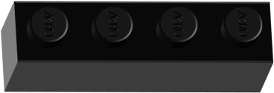
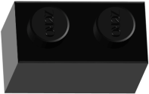

Your Text
Your Text
Your Text
Your Text
Your Text
Your Text
Your Text
Your Text
Your Text
Notes:
Alt Board 1 (Red Green Wall)- The ‘wall’ boards have the added restriction that students must choose either above or below the black ‘wall’ and then stay on that side of it for their next choice, as well (i.e. not mix a red block from above the wall with a green block from below the wall, or vice versa). Click on the text boxes to edit them for your lesson content. NOTE- deleting, moving, or altering animations for other objects may cause problems with the animation sequences. Game and template design by Adam Groff.

Slide 16
Your Text
Your Text
Your Text
Your Text
Your Text
Your Text
Your Text
Your Text
Your Text
Notes:
Alt Board 2 (Red Green)- Click on the text boxes to edit them for your lesson content. NOTE- deleting, moving, or altering animations for other objects may cause problems with the animation sequences. Game and template design by Adam Groff.

Slide 17
Your Text
Your Text
Your Text
Your Text
Your Text
Your Text
Your Text
Your Text
Your Text
Notes:
Alt Board 2 (Red Green Wall)- The ‘wall’ boards have the added restriction that students must choose either above or below the black ‘wall’ and then stay on that side of it for their next choice, as well (i.e. not mix a red block from above the wall with a green block from below the wall, or vice versa). Click on the text boxes to edit them for your lesson content. NOTE- deleting, moving, or altering animations for other objects may cause problems with the animation sequences. Game and template design by Adam Groff.

Slide 18
Your Text
Your Text
Your Text
Your Text
Your Text
Your Text
Your Text
Your Text
Your Text
Notes:
Alt Board 3 (Red Green)- Click on the text boxes to edit them for your lesson content. NOTE- deleting, moving, or altering animations for other objects may cause problems with the animation sequences. Game and template design by Adam Groff.

Slide 19
Your Text
Your Text
Your Text
Your Text
Your Text
Your Text
Your Text
Your Text
Your Text
Notes:
Alt Board 3 (Blue Green)- Click on the text boxes to edit them for your lesson content. NOTE- deleting, moving, or altering animations for other objects may cause problems with the animation sequences. Game and template design by Adam Groff.

Slide 20
Your Text
Your Text
Your Text
Your Text
Your Text
Your Text
Your Text
Your Text
Your Text
Notes:
Alt Board 4 (Blue Green)- Click on the text boxes to edit them for your lesson content. NOTE- deleting, moving, or altering animations for other objects may cause problems with the animation sequences. Game and template design by Adam Groff.

Slide 21
Your Text
Your Text
Your Text
Your Text
Your Text
Your Text
Your Text
Your Text
Your Text
Notes:
Alt Board 4 (Red Green Wall)- The ‘wall’ boards have the added restriction that students must choose either above or below the black ‘wall’ and then stay on that side of it for their next choice, as well (i.e. not mix a red block from above the wall with a green block from below the wall, or vice versa). Click on the text boxes to edit them for your lesson content. NOTE- deleting, moving, or altering animations for other objects may cause problems with the animation sequences. Game and template design by Adam Groff.

Slide 22

Your Text
Your Text
Your Text
Your Text
Your Text
Your Text
Your Text
Your Text
Your Text
Notes:
Alt Board 5 (Red Green)- Click on the text boxes to edit them for your lesson content. NOTE- deleting, moving, or altering animations for other objects may cause problems with the animation sequences. Game and template design by Adam Groff.

Slide 23
Your Text
Your Text
Your Text
Your Text
Your Text
Your Text
Your Text
Your Text
Your Text
Notes:
Alt Board 5 (Red Green Wall)- The ‘wall’ boards have the added restriction that students must choose either above or below the black ‘wall’ and then stay on that side of it for their next choice, as well (i.e. not mix a red block from above the wall with a green block from below the wall, or vice versa). Click on the text boxes to edit them for your lesson content. NOTE- deleting, moving, or altering animations for other objects may cause problems with the animation sequences. Game and template design by Adam Groff.

Slide 24

Your Text
Your Text
Your Text
Your Text
Your Text
Your Text
Your Text
Your Text
Your Text
Notes:
Alt Board 6 (Red Green)- Click on the text boxes to edit them for your lesson content. NOTE- deleting, moving, or altering animations for other objects may cause problems with the animation sequences. Game and template design by Adam Groff.

Slide 25
Your Text
Your Text
Your Text
Your Text
Your Text
Your Text
Your Text
Your Text
Your Text
Notes:
Alt Board 6 (Blue Green)- Click on the text boxes to edit them for your lesson content. NOTE- deleting, moving, or altering animations for other objects may cause problems with the animation sequences. Game and template design by Adam Groff.

